Slide 1




Enhancing Multiclass Skin Lesion Classification: A Deep Learning vs. Hybrid Deep Learning-Machine Learning Comparison on ISIC-2017 and HAM10000 Datasets
ISIC 2017 SKIN LESION CLASSIFICATION CHALLENGE:
Presentation by:
Daniel Tweneboah Anyimadu

Slide 2
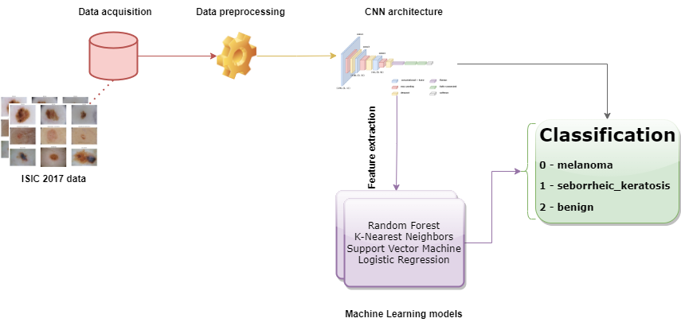
ABSTRACT
The experiment is conducted on the ISIC 2017 and HAM10000 skin lesion classification dataset. The project involves data acquisition and preprocessing, development of CNN architecture, classification and feature extraction, training and fine-tuning of machine learning models, and evaluation of performance.
The models are evaluated based on their overall accuracy and Balanced Multiclass Accuracy on a test dataset.
The hybrid model outperforms the pure deep learning approach, achieving a 90.56% accuracy and 90.56% BMA compared to 85.18% accuracy and 85.20% BMA for pure deep learning on ISIC 2017 dataset.
This study presents a multiclass skin lesion classification challenge and leverages two distinct approaches: pure deep learning and hybrid deep learning-machine learning, to assess by comparing their performance on this challenge.
The aim is to enhance multiclass skin lesion classification leveraging these 2 approaches.
2

Slide 3
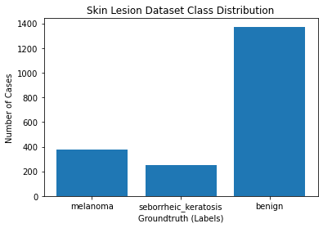
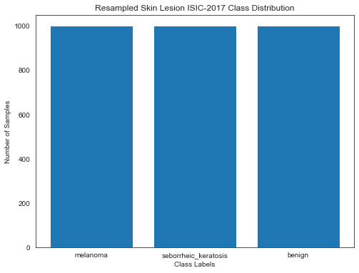
Exploratory Data Analysis (EDA) & Resampling
Class Distribution Plot:
Resampling Plot:
A visualization of class imbalance shown in the class distribution plot.
Resampling was employed to address class imbalance, enhancing the multiclass classification task. This minimized bias in the skin lesion data, as seen in the resampling plot.
3

Slide 4
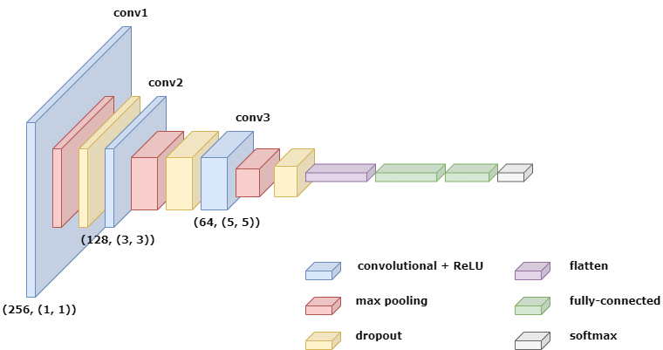
A Pure Deep Learning Approach
Convolutional Neural Network Architecture:
This is designed to automatically extract skin lesion features for multiclassification task.
4

Slide 5
Hybrid Deep Learning-Machine Learning Approach
Convolutional Neural Network:
The same CNN architecture was used to extract features as input for the ML models.
Machine Learning Models:
Different ML models, including random forest classifiers (RF), k-nearest neighbors (KNN), logistic regression (LR), and support vector machines (SVM), were trained using a supervised learning approach.
The rf model outperformed others making it the chosen final ML multiclassification model.
EVAL. METRIC / MODEL | accuracy | precision | recall | F1-score | roc_auc | bma
rf | 0.9056 | 0.9057 | 0.9056 | 0.9050 | 0.9787 | 0.9056
SVM | 0.6278 | 0.6253 | 0.6278 | 0.6209 |  | 0.6278
KNN | 0.6978 | 0.7012 | 0.6978 | 0.6900 | 0.864 | 0.6978
lm | 0.6289 | 0.6300 | 0.6289 | 0.6231 | 0.7930 | 0.6289
5

Slide 6
COMPARATIVE ANALYSIS (ACCURACY, BMA)
MODEL | ACCURACY (TEST) | BMA (TEST) | DATASET (TEST)
Pure Deep-Learning | 0.8518 | 0.8520 | ISIC 2017
Hybrid Deep Learning-Machine Learning (rf) | 0.9056 | 0.9056 | ISIC 2017
Pure Deep-Learning | 0.8533 | 0.8545 | HAM10000
Hybrid Deep Learning-Machine Learning (rf) | 0.9221 | 0.9221 | HAM10000
The results demonstrate that the hybrid model outperforms the pure deep learning approach, achieving a 90.56% accuracy and 90.56% BMA compared to 85.18% accuracy and 85.20% BMA for pure deep learning on ISIC 2017.
For further validation, the algorithm leveraged on the HAM10000 dataset achieves an impressive accuracy of 92.21% and a BMA of 92.21%, as opposed to 85.33% accuracy and 85.45% BMA obtained by the pure deep learning approach.
The hybrid approach, combining CNNs and Random Forest Classifier, reliably classifies skin lesions using both ISIC 2017 and HAM10000 datasets, showing promising potential for accurate medical diagnosis.
6

